Slide 1
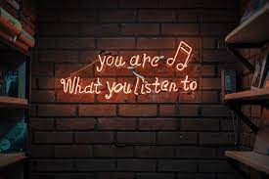
The Relationship Between Music Taste and Personality
By. Jalen Powell

Slide 2

What is music taste?
Most people understand musical taste as one’s preferences in music.
For example: someone’s music taste can be shown through particular genres, styles, or music bands.
Music plays an important role in the lives of people around the world because we use music for different facets in our life.

Slide 3
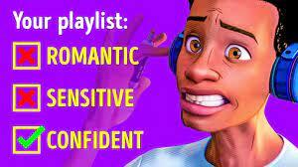
What does your music taste say about you?
According to David Greenberg, a psychologist at the University of Cambridge, “People who are high on empathy may be preferring a certain type of music compared to people who are more systematic.”
Music can create your own space as you listen to it, while also being a excellent way to connect with others.
The lyrics you listen to in a song can actually affect your personality.

Slide 4

Can your music taste become contagious?
Music has been described as “the Great Divider” due to vast amount and variety.
No one’s musical taste fully aligns with anyone else’s and we can live with the understanding that we all enjoy different artist.
Music is not subjective, but someone’s taste is subjective.

Slide 5
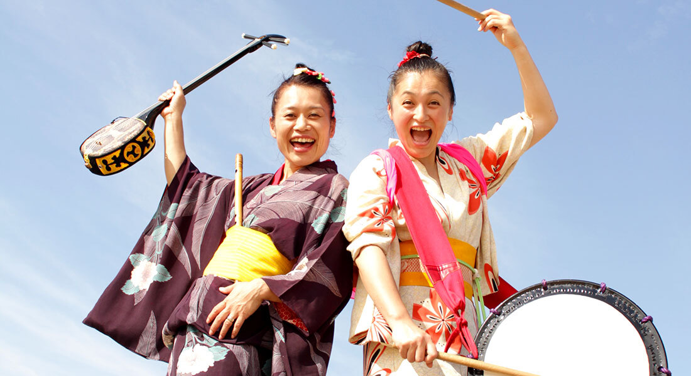
Why is music important to different cultures?
Music means a lot of different things for different people. No matter where you live or your culture, its very likely that music will make up some part of it.
Music helps express our own identity. It can influence the type of friends you have, type of clothes you wear, or type of activities you like to enjoy.

Slide 6
Relating with others using Music
The link between music preferences and personality is so strong that one skim through another person’s playlist or music folder would unveil a large amount of information about that person.
According to Spotify, “Listening to Blues or “Brooding” music like Take Care by Drake has an inverse relationship with self-assessing for “emotional stability.”
After studies conducted in 2007, research explains that people who listen to the same music also share the same attributes.

Slide 7

The Personality displayed through Music.
Music taste has almost a direct connection to the way a person make act or look.
I love to listen to Hip Hop and R&B while I’m doing almost anything because it normally calms my mind.
Either you can learn about a person’s character through their music taste or learn about their music taste through the person’s character.

Slide 8
Closing Remarks
Musical taste to me is determined from where you grow up in the world, who you grow up with, and what kind of person you are.
Music can stick to you for long periods of time but your taste does change more often than not.
When it comes to meeting new people, it’s always interesting to know what kind of music they listen to.

